Slide 1
Welcome to Game Mod Workshop!

Slide 2
What will you do in this class?

Slide 3
What will you do in this class?
Create and iterate a game that is:
Short (one minute long)
Polished
Innovative

Slide 4
Shoot for
1 Minute of Awesome Gameplay

Slide 5
Pick your goal for this class
Win game festivals
Create a commercial indie success
Show game in an art gallery
Land your dream job (goal too small)

Slide 6
How will you make your games?
Form teams of 1-5 students
that will last the entire quarter
Use Unity as the game engine
Use Perforce as version control
Use Discord for constant communication

Slide 7
How will you make GOOD games?
You must check in with team at least twice a day on Discord. For example, you could post:
some new thing you made / changed in the game
a comment on a teammate’s post
You must meet or work together as a team at least twice a week OUTSIDE of class

Slide 8
How will you make GOOD games?
Constantly think about what YOU could do to improve your game and then run it by your team before you do it.
Never wait to be told what to do. Constantly ask team what is needed and be proactive.

Slide 9
How will you make GOOD games?
Put in 20-30 hours a week on your games.
Seek and use DAILY feedback on your work
Get it from anyone on Discord, playtesters, roommates, anyone who’ll be honest and critical
RAPIDLY iterate your art, design, code, audio

Slide 10
How will you make GOOD games?
Designers should spend 80% of their time WORKING IN ENGINE either programming, iterating on parameter settings, playing with timing, scale of objects, blocking layouts, etc.
Programmers and Artists if your designers are not spending a ton of time in engine remind them to. If they still don’t tell me so I can help.

Slide 11
How will you make GOOD games?
Your games must use only 1 or 2 buttons as input.
No mouse or game controller controls
I’m tired of Game Mod Workshop games sucking. They ALWAYS suck because students go way over scope and never finish early enough to polish their games. Limiting your games to 1 or 2 buttons will allow polish

Slide 12
Unity is super flexible
Can do 2D, 3D and any game genre basically
Good for games of movement or action:
hit, shoot, slap, slide, flap, a new thing you invent
Do not make a game in these genres because you wont complete and polish it in a quarter:
adventure
role-playing
strategy
puzzle

Slide 13
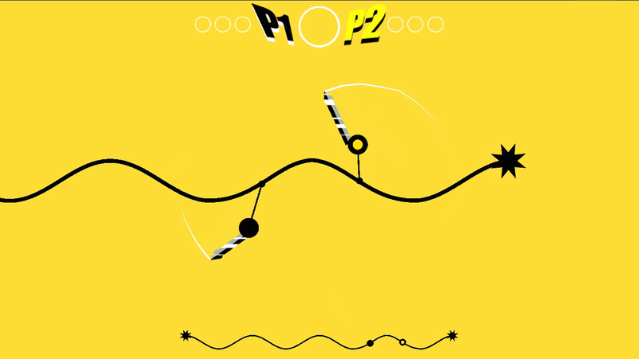
Invent a cool new mechanic and build your game up around that
PSHNGGG!
Created in several days during the “train jam” by DePaul student Chris Wade other folks. Shown at the Game Developers Conference in 2015

Slide 14
Invent a cool new mechanic and build your game up around that
OmniBus
Created by DePaul students Amir Badri and Jeremy Crockett in about a quarter. Shown at Bit Bash and Boston Festival of Indie Games. Kickstarter still going with +$5,000

Slide 15
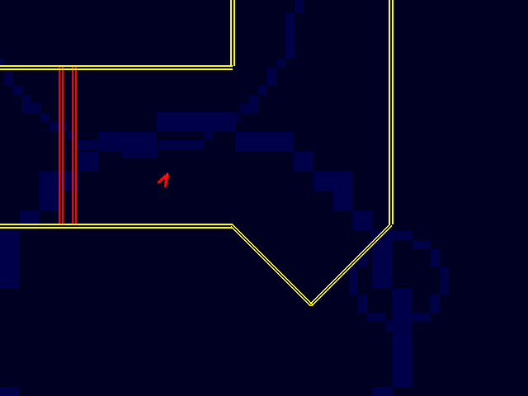
Invent a cool new mechanic and build your game up around that
Flywrench (not a DePaul game)
A frenetic action game from the makers of Nidhogg about piloting an aerobatic ship through the depths of space.

Slide 16
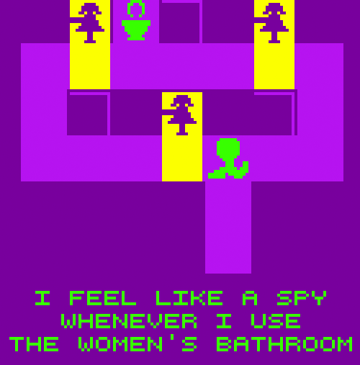
… or create a festival-worthy art game less about action and more about experience

Slide 17
Innovative minimal input games
Get on Top by Bennett Foddy
Soccer Physics by Otto-Ville Ojala
Super Hexagon by Terry Cavanagh
Gamma IV by Cactus
Pancake by Philipp Stollenmayer
Line Wobbler by Robin Baumgarten

Slide 18
Innovative minimal input games
AtomWorks by Martian Made Games
Incredipede or How to be a Tree
Punch the Custard by George Buckenham
Realistic Kissing Simulator by Jimmy Andrews and Loren Schmidt
Hit Me by Kaho Abe

Slide 19
Before the next class each of you will have to BRAINSTORM game ideas by yourself and then PITCH your best idea to your team

Slide 20
To create your best ideas follow these steps:
Find Inspiration
Form your Problem-Statement
Brainstorm Ideas around Statement
Rate and Select Best Game Idea

Slide 21
To create your best ideas follow these steps:
Find Inspiration
Form your Problem-Statement
Brainstorm Ideas around Statement
Rate and Select Best Game Idea
YOU NEED TO REFER TO THE READING
YOU NEED TO REFER TO THE READING

Slide 22
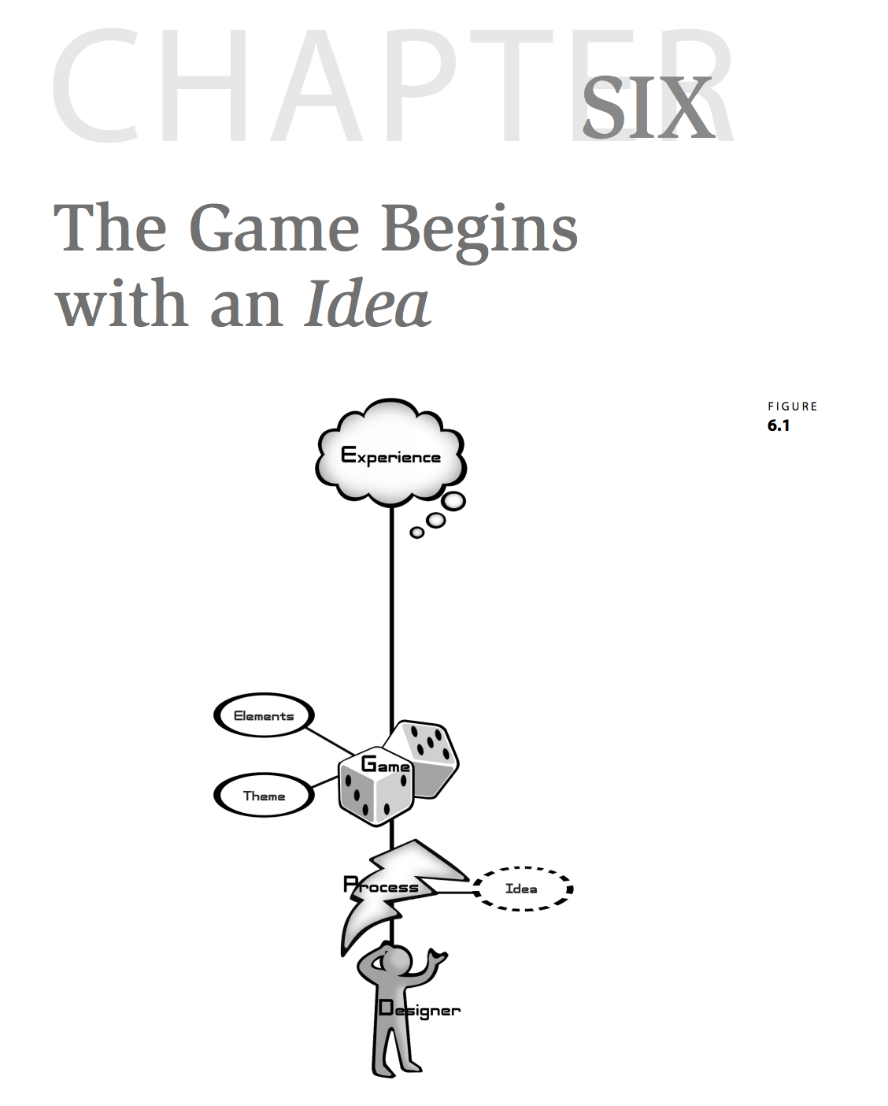
YOU NEED TO REFER TO THE READING
YOU NEED TO REFER TO THE READING

Slide 23
To create your best ideas follow these steps:
Find Inspiration
Form your Problem-Statement
Brainstorm Ideas around Statement
Rate and Select Best Game Idea

Slide 24
Be inspired by something. What are some things that inspire you? The more unusual and unique the better.

Slide 25
Even hate can be inspiring! ☺

Slide 26
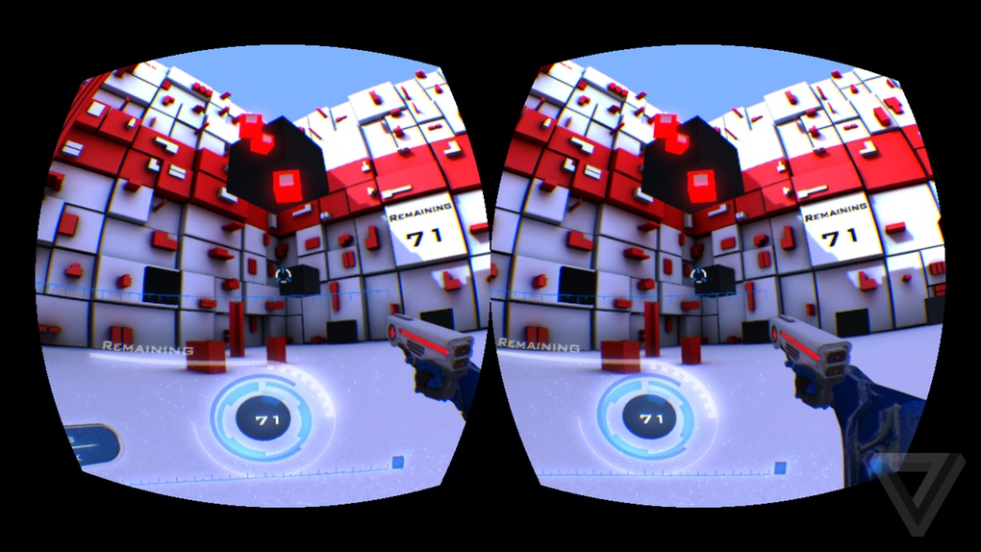
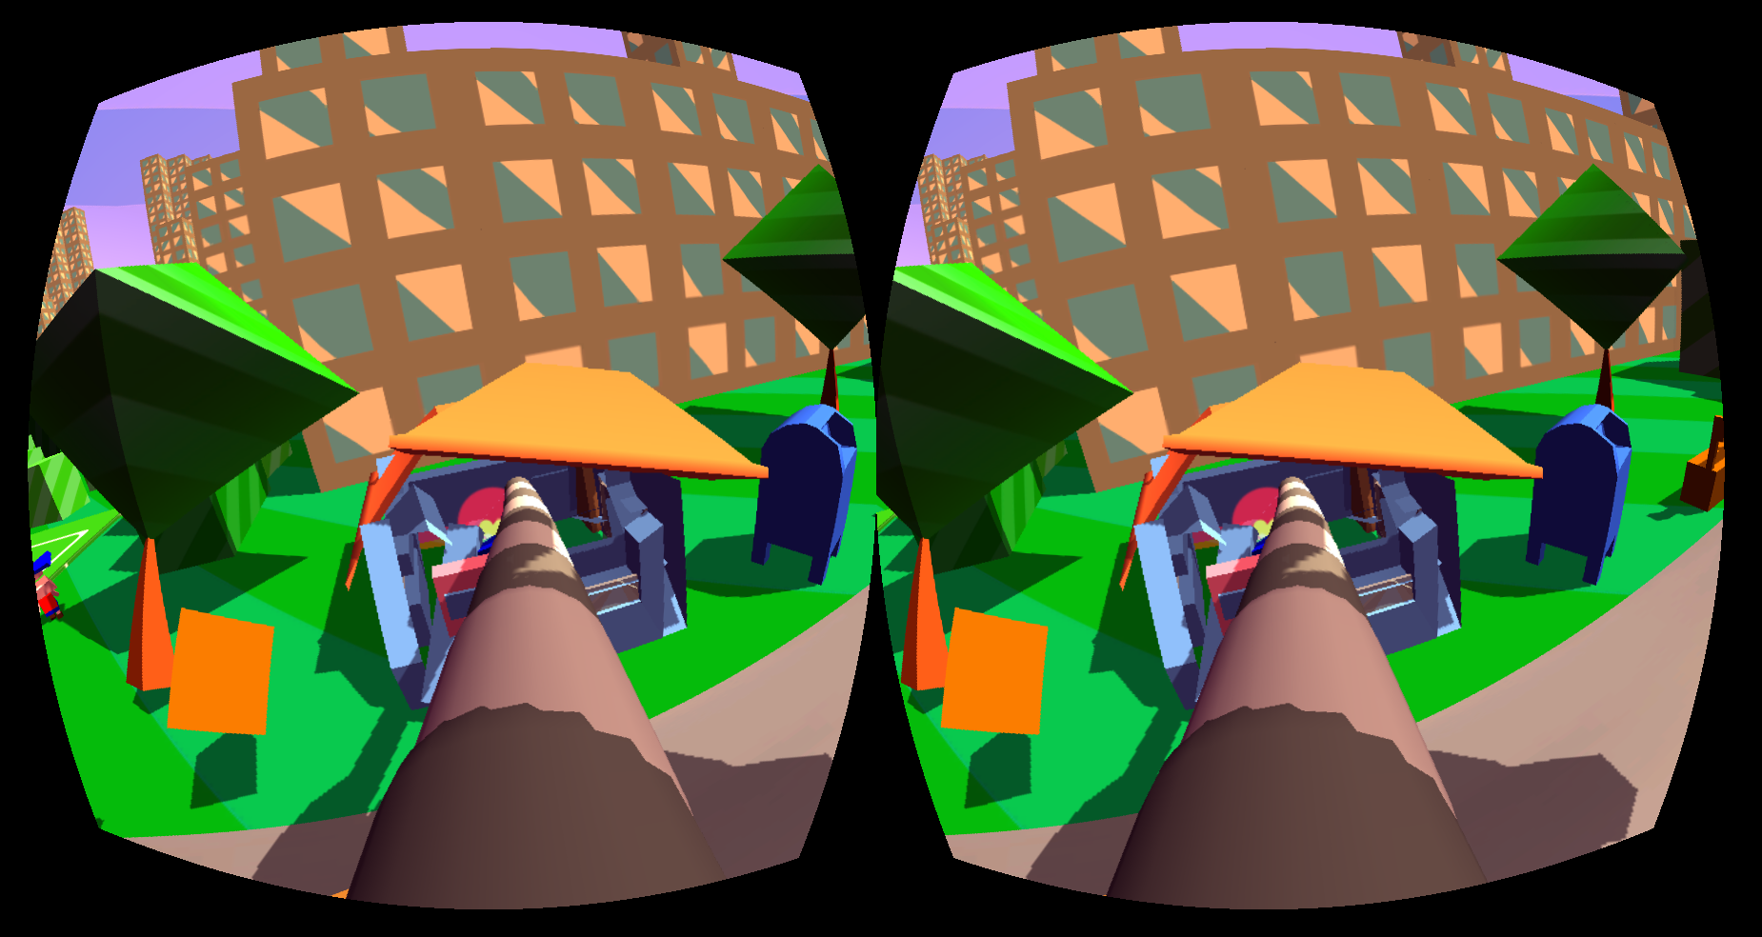
Be inspired by something…
Dumpy: Going Elephants (VR Game)
Inspired by how bad VR games were on the Oculus Rift
Game won awards, $5,000, shown internationally

Slide 27
To create your best ideas follow these steps:
Find Inspiration
Form your Problem-Statement
Brainstorm Ideas around Statement
Rate and Select Best Game Idea

Slide 28
Inspiration Leads to a Problem Statement.
How can a game…
use head rotation in VR as easy & novel mechanic?
blend spinning tops + lightning in a cool way?
feel like a Surrealist painting?

Slide 29
To create your best ideas follow these steps:
Find Inspiration
Form your Problem-Statement
Brainstorm Ideas around Statement
Rate and Select Best Game Idea

Slide 30
Before Brainstorms
Feed your unconscious mind beforehand
Do something you LOVE TO DO like eat chocolate, tacos, sleep in, run, or whatever
Do something you NEVER DO like zone out to techno, walk in woods, eat Ethiopian food, etc.

Slide 31
Before Brainstorms
Find a suitable place to brainstorm
away from too much distraction
Relax and turn your critical mind off.
don’t criticize yourself or your ideas

Slide 32
During Brainstorms
Stick to one-liners to describe ideas
Focus ideas around your problem-statement

Slide 33
During Brainstorms
Stick to one-liners to describe ideas
Focus ideas around your problem-statement:
How can a VR game on the Oculus Rift only use head rotation as an easy & novel mechanic?

Slide 34
During Brainstorms
Stick to one-liners to describe ideas
Focus ideas around your problem-statement:
How can a VR game on the Oculus Rift only use head rotation as an easy & novel mechanic?
Player is elephant with floppy trunk sticking out of face he swings around to destroy cartoon city.

Slide 35
During Brainstorms
Stick to one-liners to describe ideas
Focus ideas around your problem-statement:
How can a VR game on the Oculus Rift only use head rotation as an easy & novel mechanic?
Player is elephant with floppy trunk sticking out of face he swings around to destroy cartoon city.
Player has sleep paralysis and must look at demons around bed to stop world from collapsing into hell.

Slide 36
During Brainstorms
Stick to one-liners to describe ideas
Focus ideas around your problem-statement:
How can a VR game on the Oculus Rift only use head rotation as an easy & novel mechanic?
Player is elephant with floppy trunk sticking out of face he swings around to destroy cartoon city.
Player has sleep paralysis and must look at demons around bed to stop world from collapsing into hell.
Player moves head to swim like a space salmon.

Slide 37
During Brainstorms
Stick to one-liners to describe ideas
Focus ideas around your problem-statement:
How can a VR game on the Oculus Rift only use head rotation as an easy & novel mechanic?
Player is elephant with floppy trunk sticking out of face he swings around to destroy cartoon city.
Player has sleep paralysis and must look at demons around bed to stop world from collapsing into hell.
Player moves head to swim like a space salmon.
Other ideas?

Slide 38
During Brainstorms
Do NOT weigh or consider the value of your ideas they arise!
just write each idea down quickly
If you get stuck take a silent 5 minute break to clear your mind and stress
Go for quantity over quality
Number your ideas as you go
Come up with at 40-100 different ideas. Yes 100.
If feeling really blocked go back to step one and find new inspiration

Slide 39
To create your best ideas follow these steps:
Find Inspiration
Form your Problem-Statement
Brainstorm Ideas around Statement
Rate and Select Best Game Idea

Slide 40
After Brainstorms
Turn your critical mind back on

Slide 41
After Brainstorms
Turn your critical mind back on
Rate each idea from 1-5 by how EASY the game would be to develop.
Consider its needs in art, programming, audio

Slide 42
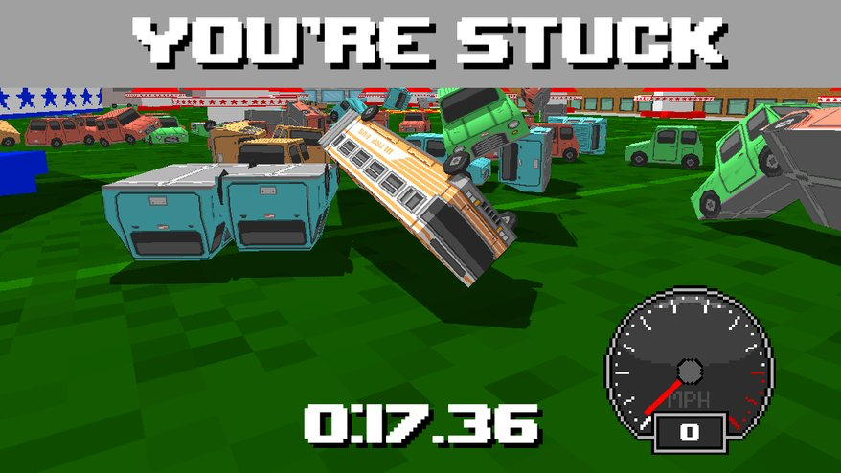
Pick a game easy to prototype
5 (super easy)
5 (super easy)
5 (super easy)
5 (super easy)

Slide 43
Pick an art style easy to polish
4 (pretty easy if tech artist)
5 (super easy)
5 (super easy)
5 (super easy)

Slide 44
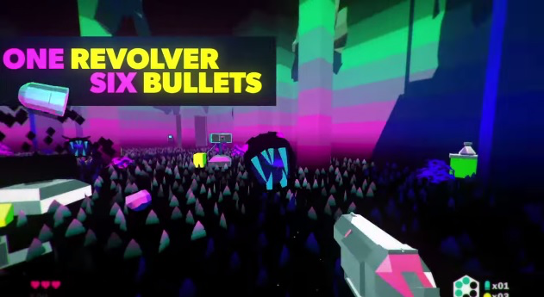
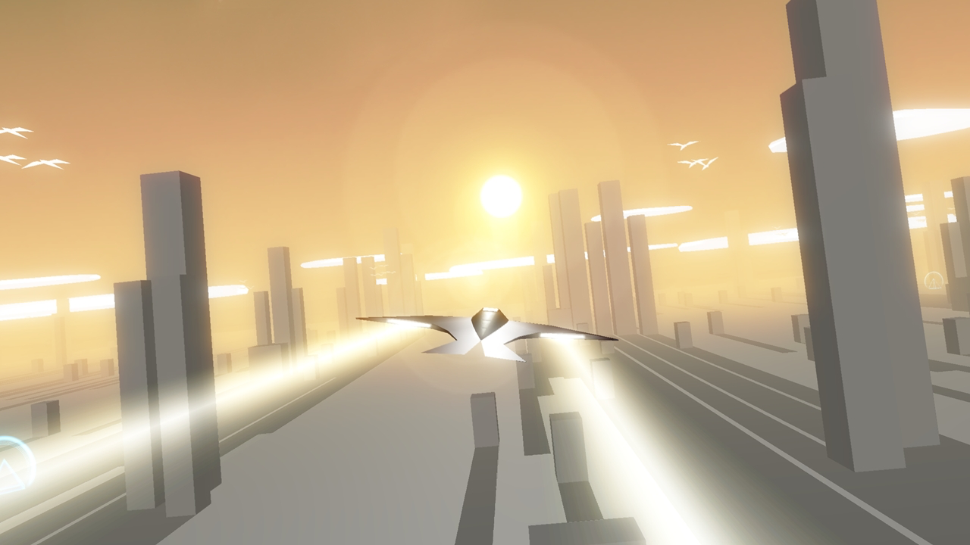
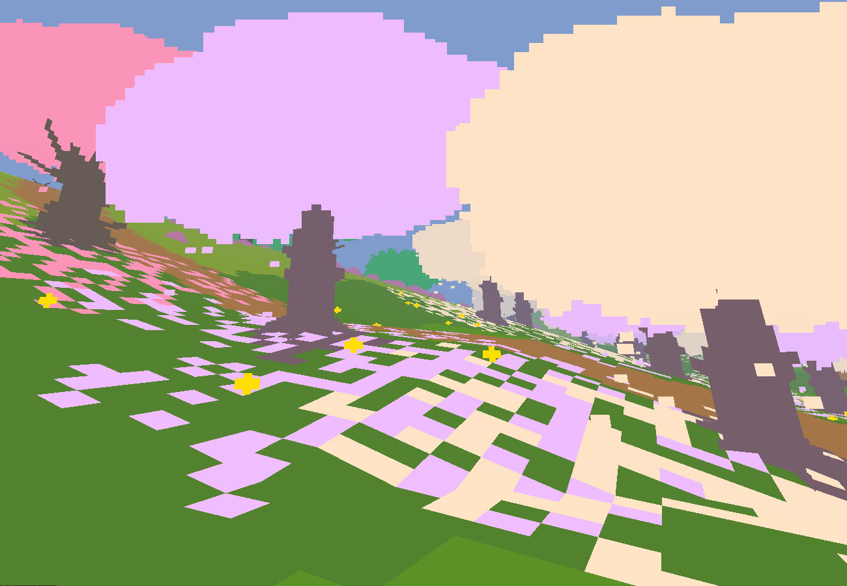
How to make 3D easy to polish

Slide 45
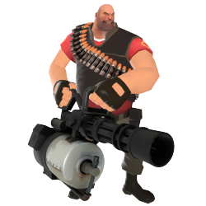
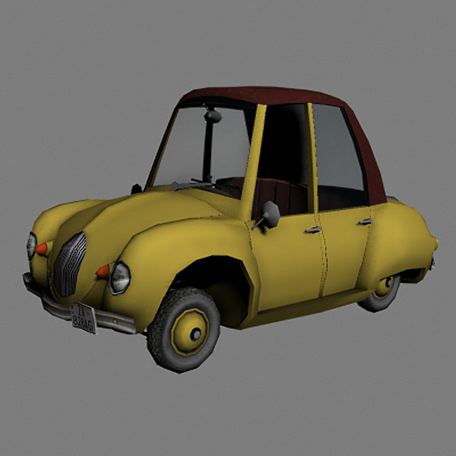
Do not pick anything even semi-realistic!
1 (very difficult)
1 (very difficult)
1 (very difficult)

Slide 46
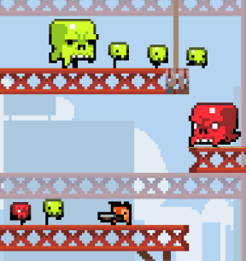
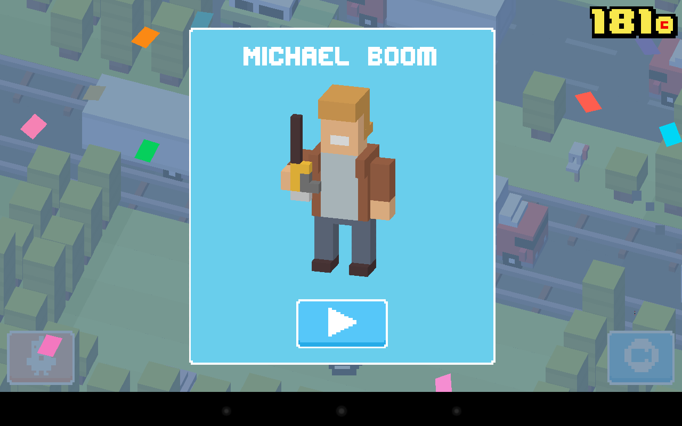
If your idea has humans make them super simple
4 (pretty easy)
5 (super easy)
4 (pretty easy)
4 (pretty easy)
4 (pretty easy)

Slide 47
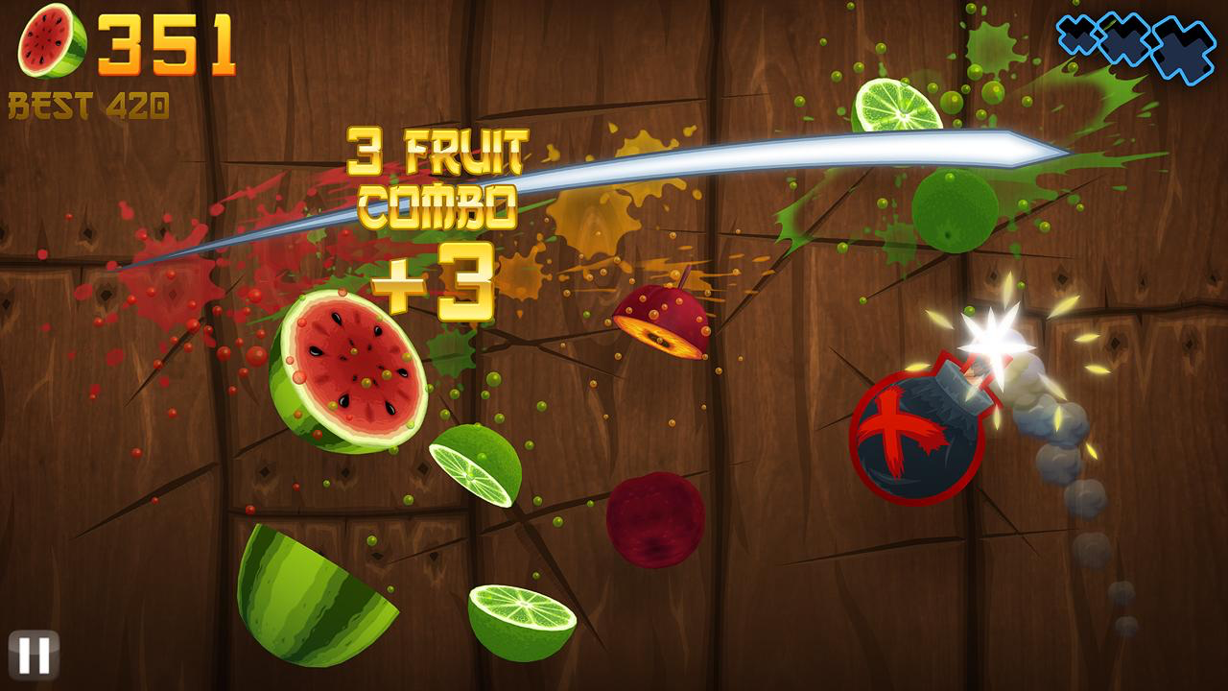
If you want to do semi-realistic, then only pick simple content like fruit, eyeballs, boxes, etc.
2 (pretty hard)

Slide 48
After Brainstorms
Turn your critical mind back on
Rate each idea from 1-5 by how EASY the game would be to develop.
Consider its needs in art, programming, audio.
Rate each idea from 1-5 by how INNOVATIVE and appealing the game would be
What kind of game would most stand out in the commercial market and/or in game festivals?

Slide 49
Pick a game design that’s innovative
5 (game goal was to fit in at Burning Man)
5 (“brutal casual” one button)
5 (Nidhogg+Pivvot mashed together)
5 (autobio on transgender)

Slide 50
After Brainstorms
Turn your critical mind back on
Rate each idea from 1-5 by how EASY the game would be to develop.
Consider its needs in art, programming, audio.
Rate each idea from 1-5 by how INNOVATIVE and appealing the game would be
What kind of game would most stand out in the commercial market and/or in game festivals?
Pitch your highest rated idea to teammates (score of 10 is max, 5 easy + 5 innovative).

Slide 51
Reviewing what is Due before next class:
Individuals brainstorm, coming up with 40-100 ideas
Individuals evaluate which of their 40-100 ideas are best using the 1-5 scoring method for easy/innovative
Teams meet and discuss everyone’s best ideas. Don’t pick your ideas yet! Just discuss what’s interesting.
Then teams brainstorm together around all the ideas pitched. Improve upon them in real-time so they would be easier to make and as innovative as possible.

Slide 52
Any questions so far?

Slide 53
Think BIG
Don’t wish just to land a job in the game industry.
Imagine being an industry LEADER someday.

Slide 54
Recipe for Success
Be open
Be professional. Treat everyone well.
There are no stupid questions. Ask away.
GOOGLE SOLUTIONS AND REFERENCES
To solve problems, search like crazy for solutions.
Hunger for critical feedback from everyone.
It’s the easiest way to make EXCEPTIONAL work.
Be a vibrant member of the class & your team.
Continually participate and communicate.

Slide 55
Class Website
www.GameModWorkshop.com

