Slide 1
Playtesting
Game Mod workshop – Brian Schrank

Slide 3
You
X
game
players

Slide 5
Tissue tests
Find people who’ve never seen your game. Why?
They have fresh eyes.
They tell you what should be obvious.

Slide 6
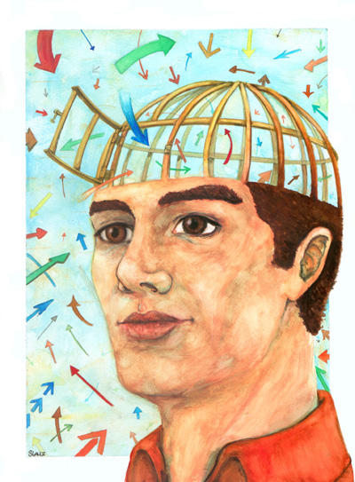
Tissue tests
They have open minds.
They reveal LOW HANGING FRUIT.

Slide 7
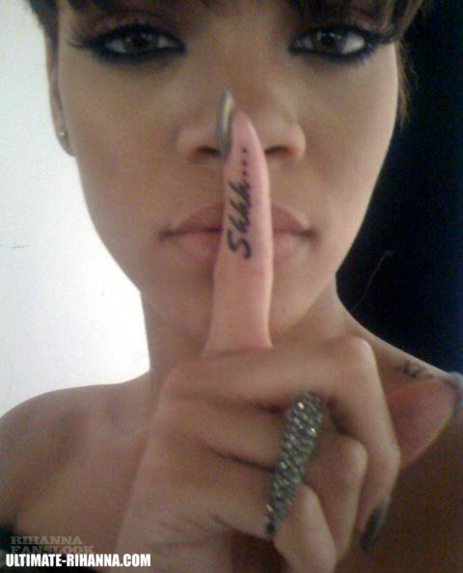
How to conduct playtests
Say as little as possible before they play.
Let the game speak for itself.
Show them the controls and that’s it.

Slide 8
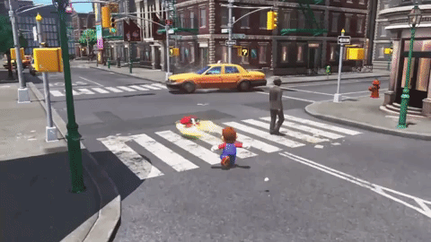
Allow Playtesters to:
Fail… only help them figure something out once you’ve learned all you can
Find fun… players screwing around can help you discover new/alt gameplay

Slide 9
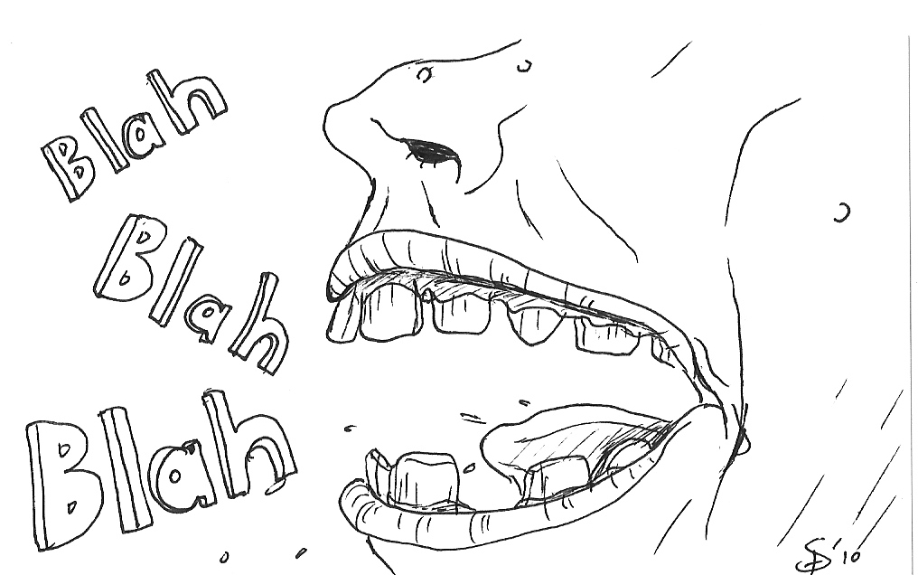
What’s the Think aloud protocol?

Slide 10
What’s the Think aloud protocol?
Encourage the player to verbalize all their internal thoughts.
It’s supposed to be a stream-of-consciousness ramble.

Slide 11
4 Types of game testing
Focus Testing
Quality Assurance (Bugs)
Usability
Playtesting

Slide 12
4 Types of game testing
Focus Testing
Quality Assurance (Bugs)
Usability
Playtesting

Slide 13
During the Playtest ask these questions in your head:
What are the bugs?
Do players understand how to play?
Where do players get stuck?
When do players have the most fun?
What could be added/removed to add fun?

Slide 14
IMMEDIATELY After playtesting:
Give a short Google Doc survey.
Then give an in-person interview.

Slide 15
survey questions
I understand what to do in the game.
The controls are balanced for the game.
The game is appropriately challenging.
Level 1 is as long, difficult etc. as it should be.
The prototype A is fun to play.
The prototype B is fun to play… and so on.
The display (health bar, etc.) is easy to understand.

Slide 16
survey answer format
Use 5 Scale System (it’s proven to work):
5=strongly agree
4=somewhat agree
3=neither agree nor disagree
2=somewhat disagree
1=strongly disagree

Slide 17
interview questions:
What were your overall thoughts of the game?
Were you able to learn how to play quickly?
How would you describe this game to someone who has never played it before
What was most frustrating?
What was most confusing?
What was most fun?

Slide 18
Playtest
Questions?

Slide 19
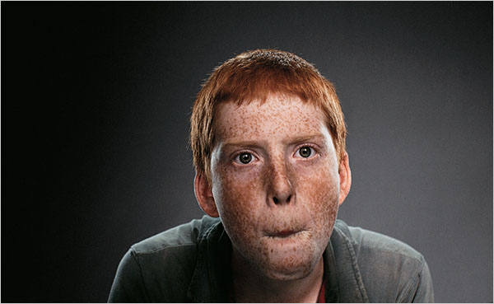
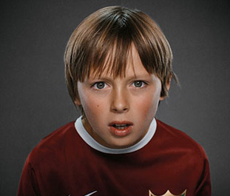
What do players really want?

Slide 20
What do players really want?
x
x
Every Game Should Provide 4 Types of Fun:
x
x

Slide 21
What do players really want?
x
x
Every Game Should Provide 4 Types of Fun:
x
x

Slide 22
Emotional timeline + Level design = fun
Fiero Hard fun
Curiosity
Easy fun

Slide 23
It’s a lesson taken from film:

Slide 24
Dominant difficulty curve used In games

Slide 25
Fun
Questions?

